Slide 1


Ian Marc Daniel Republic polytechnic
Diploma in Infocomm Security Management Ian Marc Daniel (21003919@myrp.edu.sg), Russell Low (21008441@myrp.edu.sg), Antony Thomas Kollannoor Ranjith (21026039@gmail.com), Vinith Kumar Selvam A/Ldu.sg

Slide 2
[Alibaba Cloud] Create an application that promotes sustainable consumption: This hackathon challenge would require participants to create a mobile or web application that encourages users to adopt more sustainable consumption habits. The application could offer personalized recommendations on sustainable products or services based on users' interests, location, and behavior.

Slide 3
Current Practices
Everyday, tonnes of food in urban cities is thrown away because they could not be consumed before expiry. Food wastage not only has a big impact on the environment, but also could have been better used to feed communities in need. Create a platform that connects food suppliers (restaurants, grocery stores, catering services) with local food banks and non-profit organisations.
Our Summarized Solution:
The platform aims to optimize food rescue routes, minimize transportation costs, and maximize benefits for communities in need.
Instead of wasting nearly expired or unconsumed cooked food, the platform organizes rescue efforts to redistribute these items to those in need.
Efficient collection and redistribution logistics are essential components of the platform.
The app should optimize the timing and routing of transportation to minimize costs and prevent food spoilage during redistribution.

Slide 4

Food Suppliers: Restaurants, grocery stores, catering services, and other food suppliers face the
challenge of managing surplus food that may go to waste. They need a solution to efficiently redistribute excess food and reduce their environmental impact.
Local Food Banks and Non-Profit Organizations: These organizations work towards providing food
assistance to communities in need. They rely on donations and would benefit from a platform that
connects them with food suppliers, streamlines the collection process, and ensures timely distribution of rescued food.
Communities in Need: People who face food insecurity can benefit from the optimized food rescue
efforts. By ensuring that food items close to expiry or cooked but not consumed are redistributed efficiently, more individuals and families can access nutritious meals.
Environmental Sustainability: Food wastage contributes to environmental problems such as greenhouse
gas emissions and inefficient resource utilization. By optimizing food rescue routes and reducing
transportation costs, the proposed solution can help minimize the environmental impact associated with food waste.

Slide 5

Food waste is one of the biggest waste streams in Singapore and the amount of food waste generated has grown by around 20% over the last 10 years. In 2019, Singapore generated around 744 million kg of food waste. That is equivalent to 2 bowls of rice per person per day, or around 51,000 double decker buses.
An estimated 2.5 billion tonnes of food was lost on farms or wasted by retailers or consumers globally, accounting for about 40 per cent of production, according to research by World Wildlife Fund (WWF) and British retailer Tesco.
Agricultural production, at 33 percent, is responsible for the greatest amount of total food wastage volumes.
According to the FSSAI (Food Safety and Standards Authority of India), one-third of all food in India is wasted or gets spoilt before it is eaten. According to the UNEP Food Waste Index Report 2021, household food waste in India is estimated to be around 50 kg per person annually, or 68.76 million tonnes.

Slide 6

It is estimated by the FAO that 1/3 of global food production gets lost through waste. That is a staggering figure of 1.3 billion tonnes of food wasted annually. A global cost of $400 billion is lost annually when translated into financial terms.
The results showed that an estimated 26,000 tonnes of food is thrown away from households even before it is cooked, including expired food and food that is spoiled as a result of improper storage.
In terms of monetary value, the study estimated that S$342 million worth of food was wasted across the more than one million resident households in Singapore.
Other than just the monetary impact, food wastage also has other impacts

Slide 7

Environmental Impact: Food waste contributes significantly to climate change. When food is discarded, it often ends up in landfills where it decomposes and produces methane, a potent greenhouse gas. The Food and Agriculture Organization (FAO) of the United Nations has estimated that if food waste were a country, it would be the third-largest emitter of greenhouse gases after China and the U.S. Furthermore, the water, land, energy, and other resources used in producing, processing, transporting, and selling food are also wasted when food is thrown away.
Social Impact: While billions of pounds of food are wasted each year, nearly 690 million people worldwide go to bed hungry every night according to World Food Programme statistics. Wasting food, therefore, is a moral issue as well as a practical one. The resources spent on producing the wasted food could be directed towards more productive uses.

Slide 8
Reduce food waste by creating an application to help salvage edible food that is fit for
consumption and more so that can be given to those in need. Alternatively, food that has
expired or that which is not desirable for consumption can be put to some other good use instead of being disposed altogether.
Main problems I identified when thinking of a solution:
The existing solution in the market currently only allows manufactures to reduce food wastage. It
does not allow the regular consumer to play their part feasibly. As a matter of fact, this
snowballing problem cannot be solved by just one or two individual groups. Everyone must play their part in order to solve this problem and this can range from retailers to consumers.
How can we get the food from one location to another without heavy cost being incurred by the
donors?
Many people living in poorer communities may not have the means to travel to food bank and back
People may be deterred from going to a food bank due to the stigma that is attached to it.
What can be done about the expired food? Can it be put to better use instead of just disposing it?

Slide 9
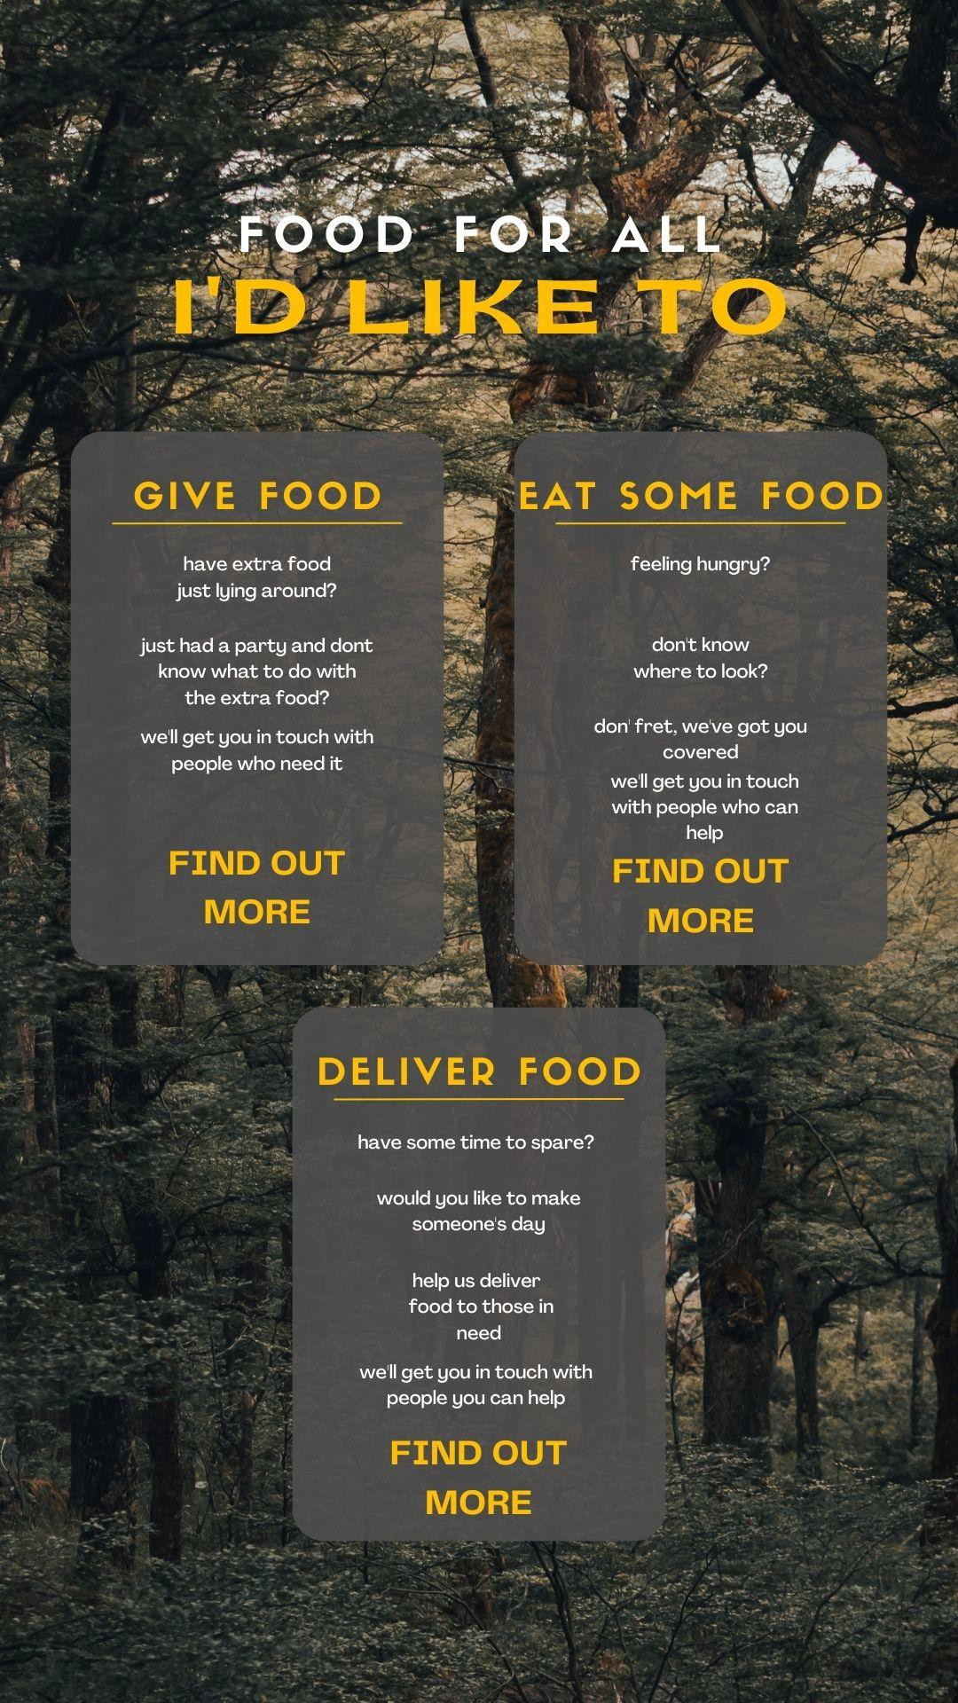

The platform will have 3 main options:
1.GIVE FOOD
The user can choose to donate food
2. EAT SOME FOOD
The user can choose to look for food
3. DELIVER FOOD
Lastly the user can choose to help to deliver the food
4. HOME
The home page where everything exists together

Slide 10
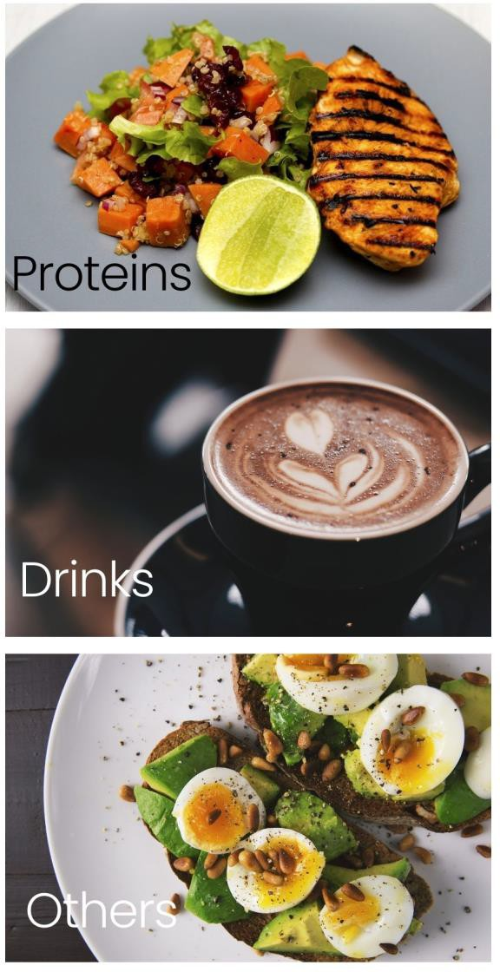

This App provides the user with the options to:
To post a picture of the food he would like to donate or give away.
Other users or food banks would be able to see this post and contact the donor for more details.
After the food bank has contacted the user they can arrange for the food to be delivered

Slide 11
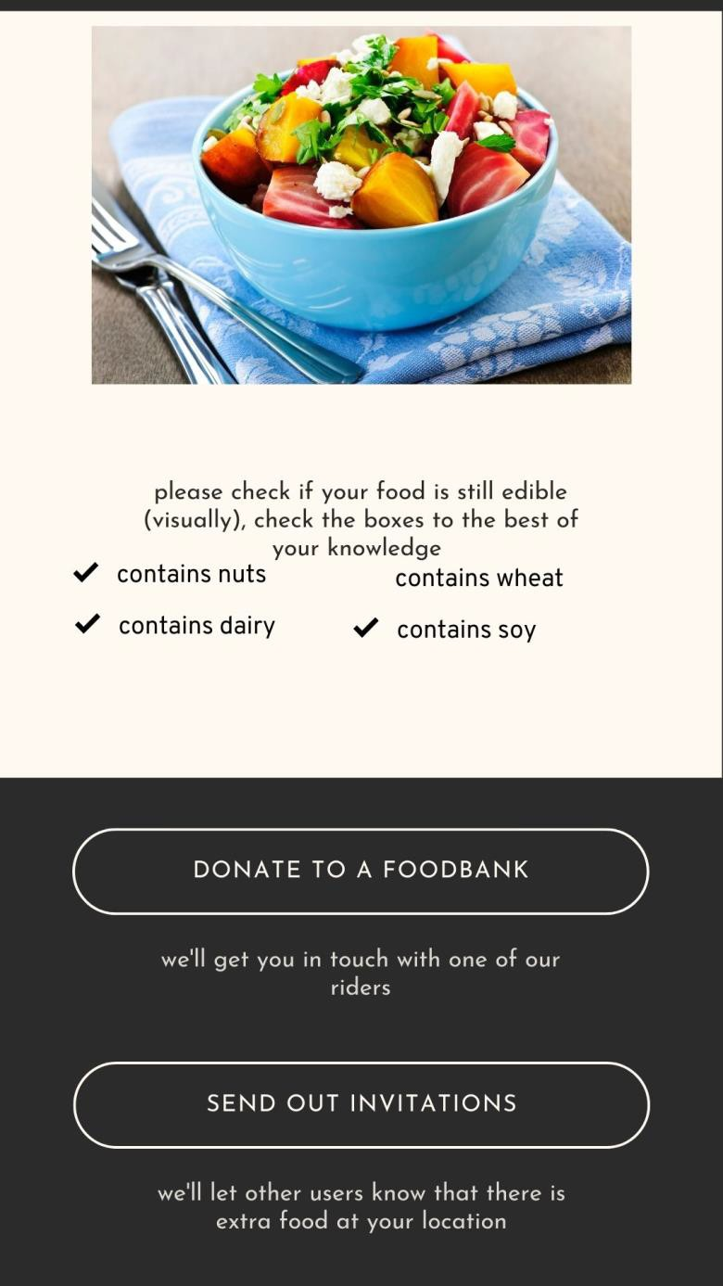

Send Out Invitations Features
Users can use the ‘send out invitations’ feature to invite
those in need to collect the food items directly from their houses or locations.
They can request the visitors to bring their own
containers to encourage reduction of single use
containers. Alternatively, donors can pack the food for them.
Lastly users can post about inedible and spoilt food to get
in touch with local farms that are willing to compost the spoilt food.
One of the key features which is especially useful for
those who do not have the means or are unable to access
a food bank especially people living in rural may look out
for donors who are ‘sending out invitations’ nearest to
them.

Slide 12
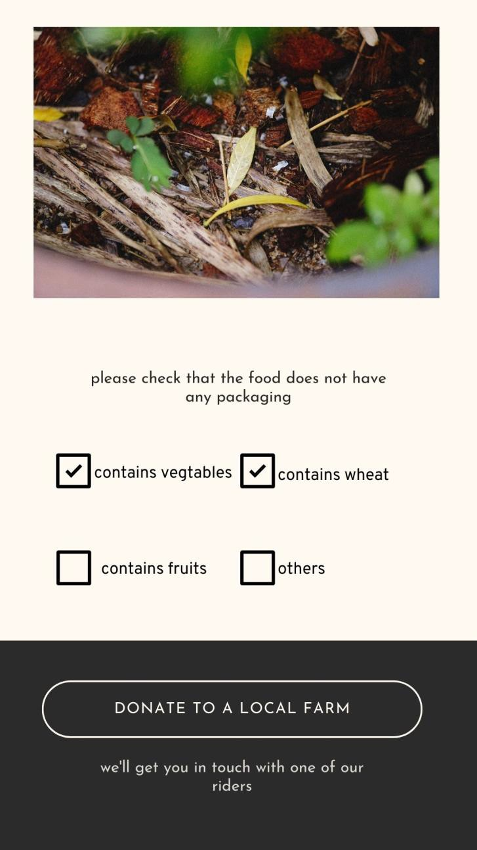

Donate to a Local Farm
Lastly some donors may find food items that are not salvageable, such as vegetables and fruits that have expired or cannot be consumed.
Although humans may not be able to eat these food items, they can always be given to farmers who can put these unwanted food items to good use.

Slide 13
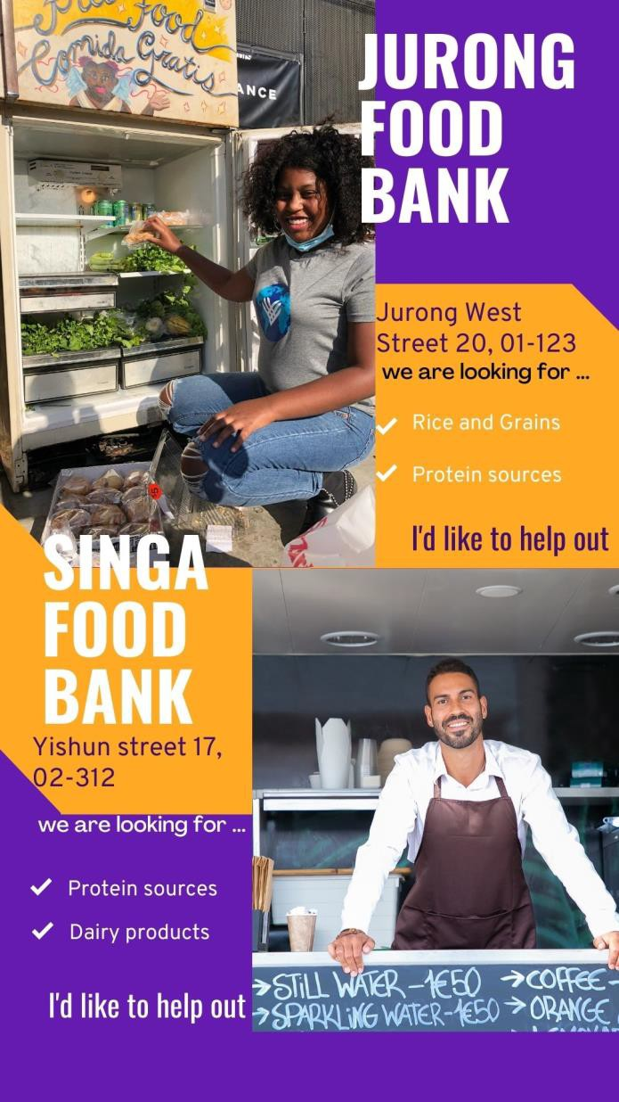
Food Banks
When this option is chosen, we will connect the user with other users who have sent out invitations or with food banks.
This option helps them to select the nearest location where they can find some food.

Slide 14
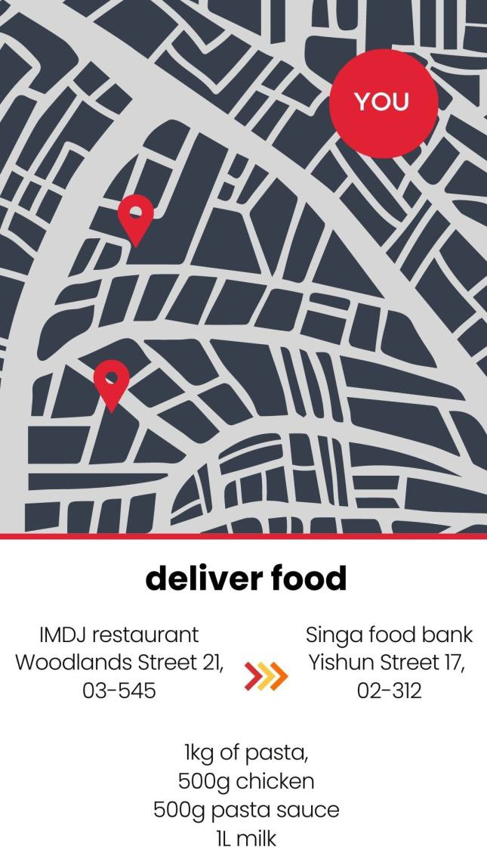
Deliver Food
When this option is chosen, we can provide users with the nearest pickup point and drop of point of the donated food, ether from normal user or retail stores.
This will be the most important option in getting the food from where it originally is to where it needs to be delivered.

Slide 15
One of the main problem that I had to solve was the cost of transportation, this is why I choose to Solicit support from food delivery drivers. When the rider chooses the deliver food option, they will be given the location of the closest donor, so they can pick up the food and drop it off.
In the future, we can partner with food delivery applications so that if the donor orders some food, the delivery driver can pass them the food they just ordered and collect the donation from the donor and pass it to the nearest food bank.
If the donor's donation has been verified by the food bank, the user would get some coupons for their next purchase, and the riders would be given some compensation for their hard work.

Slide 16


This option will give the user an insight of how food waste is detrimental not just for the humans, but also for the earth.
The user can also see upcoming events where they
can volunteer to play their part in the community.

Slide 17

Post about
the food on the app
Food bank accepts the donation through the app
Delivery
is arranged
Food bank receives and verifies the donation
The donor
receives vouchers from the application
Donate food
Post about
the food on the app
Users can accept
the invitation and go to the location
Give food
Send out
invitations
Donate to
a farm
Post about
the food on the app
The Farm accepts the donation through the app
Delivery
is arranged
The Farm receives and verifies the donation
The donor
receives vouchers from the application
The application will match users with the nearest donor in their vicinity
Want food
Want food
The rider will be prompted to pick up the donation and drop it off at the food bank. (as discussed by the donor and food bank)
The rider will get some compensation for his efforts
The application will match users with the nearest donor in their vicinity
The rider will drop
off the donation
Deliver food
Deliver food
The users will be given information about food banks in the area. (e.g. food they are looking for, volunteers)
Home
Home

Slide 18


Problem | Solution
The problem cannot be solved by just a few individuals, everyone must paly their part in order to solve this problem from consumers to retailers | By opening the app to the general public making sure that not just food suppliers are part of the solution
How can we get the food from one location to another without heavy cost being incurred by the donors | We can Solicit help from delivery drivers to help us deliver food
Many people living in poorer communities may not have the means to travel to food bank and back | By implementing ‘send out invitations’ feature, we can make it more accessible for those in need to get food
People may be deterred from going to a food bank due to the stigma that is attached to it | by using the home page to educate users on how hunger is a fundamental need that all humans share
What can be done with the expired foods | By giving the spoilt foods to local farms to be put to better use

Slide 19


UglyFood was founded in 2016, with a mission to eliminate food waste and revamp the food ecosystem by selling excess or ‘ugly’ fruits and vegetables as well as its own branded products and sustainably sourced goods.
According to Crunchbase, the company previously raised US$120,000 in a pre- seed round. In 2021, it was reported that UglyFood was in talks with three investors to raise funding of about US$1 million.
Announcing on Wednesday (4 January) that it is "winding up" on its Facebook page and on Instagram, UglyFood said, "Sadly we are unable to raise the funds required to grow further, it's been a good run.“
Fresh produce that is thrown away because of its unsuitable shape, color, or size for sale. She has since expanded into the field of food management consulting, helping suppliers reduce waste and cut losses due to overestimated demand and surplus produce.

Slide 20



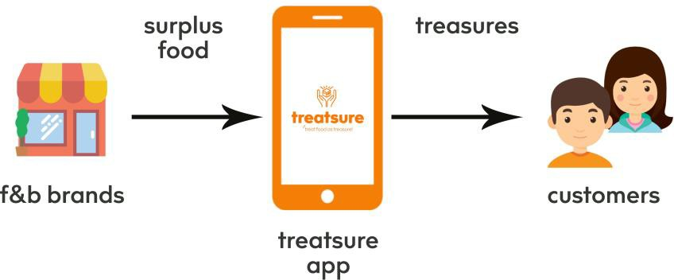
Treatsure provides an alternative solution that will help address food wastage, while providing value to merchants and everyday consumers.

Slide 21

Insectta, situated in Singapore, was created in 2017 due to a study into the zero- waste management of black army flies.
Organic waste is quickly consumed by the larvae of black soldier flies, which subsequently become animal feed for livestock.
Fertilizer may be made from insect excrement.
Black soldier fly waste may now be used in the pharmaceutical and cosmetic sectors and the animal feed industry, thanks to Insectta's efforts to extract high- value biomaterials from the waste.
Insectta collects pre-consumer food waste from the food manufacturers. This includes okara and spent grains from the beer making process which are unavoidable in the manufacturing process.

Slide 22
The market | Our solution
Uglyfood Singapore Although the solution is very effective, food waste is only collected from manufacturers, and regular. consumers may not be able to donate food Some people may not be able to afford the foods that are being sold on the website. | Regular consumers will be able to donate using the application. People with no access to food will be able to use the application in order to help them find food.
Treatsure: in the Unwanted Bin, a Treasure Trove Although the solution is very effective, food waste is only collected from manufacturers, and regular consumers may not be able to donate food. Some people may not be able to afford the foods that are being sold on the website. | - Spoilt food can be given to farms to compost.
Insectta: Let the Bugs Eat It Although the solution is very effective, food waste is only collected from manufacturers, and regular consumers may not be able to donate food. The solution does not help those in need. Good solution for composting and reusing spoilt food. | - All the other solutions does not help all parties (consumer, at a national scale).

Slide 23

In terms of monetary value, the study estimated that S$342 million worth of food was wasted across the more than one million resident households in Singapore. By reducing the amount of food wastage that happens on a national scale, we can save that money, not just as an industry, but also as consumers.
By implementing this application, we can help consumers inculcate a sense of
responsibility when it comes to global or national issues.
By connecting those in need with those who are willing to help, cutting out the middleman can help us to streamline the donation process and help those with no access to food banks.

Slide 24
Tackling Risks
The Risks | Tackling the Risk
Hygiene levels of the left-over food may not be up to par which causes potential food poisoning. | Implement a quality control process to ensure that only safe and suitable food is accepted for donation. This can involve guidelines for food donors to follow, including proper storage and handling.
Drivers delivering food for our food donation app, which redistributes leftover food to those in need, may experience a loss of motivation. | -Provide voucher incentives should they reach a certain number of donations achieved within a given month.
There may be insufficient supply to meet demands due to lack of food donations. | -Promote awareness of the application through advertisements, brochures, and social media, Tiktok , Facebook and Instagram.
People are not educated on how to consume sustainably | We can solve this problem by educating users about how their way of life is affecting the earth. We can help them by giving them recommendations on how they can play their part.

